Slide 1
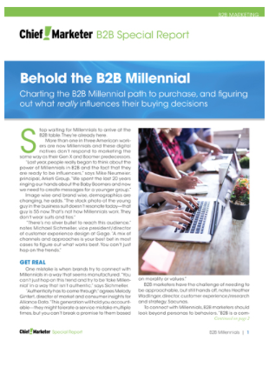
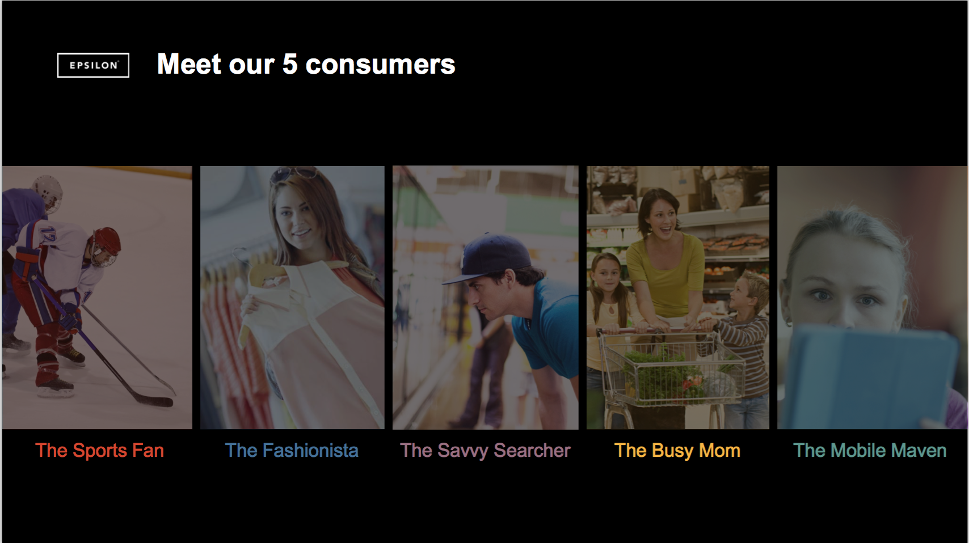
Using agency proprietary research studies as the basis for thought leadership publications, speaking engagements and press opportunities.

